Slide 1
Subreddit Classification: r/MensLib vs r/MensRights
Benjamin Dornel – DSI 18 – Singapore

Slide 2
Problem Statement
Classify posts from r/MensLib and r/MensRights based on their title and body text
Help new users post in the right subreddit (subreddit names can be highly misleading)
Allow moderators to easily identify posts that might have been posted in the wrong subreddit.

Slide 3
r/MensLib vs r/MensRights
r/MensLib:
Pro-feminist
Inclusive and broad definition of masculinity/manhood
Focus on positivity
r/MensRights:
Anti-feminist
Supports traditional and outdated gender roles
Connected to the alt-right and other highly misogynistic subreddits
Notes:
Feminism: a movement that believes in equal rights for both women and men
Pro-feminist: Gender issues are often flip sides of the same coin e.g. If a women's group is talking about getting more women into the workforce or into executive positions, the flip side men's issue is the pressure on men to be in the workforce instead of being at home, and fighting that stereotype of men not being caretakers of their family.
Open community & inclusive definition of masculinity: includes men who are gay, transexual or a person of color
Focus on positivity: aims to build a healthier, kinder, and more inclusive masculinity – generally a non-toxic community
Anti-feminist: believes monolithic feminism is the root cause of men’s issues – feminism is actively trying to harm men and take away their rights
Gender roles: men as breadwinners, women as housewives
Alt-right: misogynistic subreddits like r/TheRedPill or r/MGTOW, groups like incels are involved with MensRights.

Slide 4
Data Cleaning & Processing
Retrieved 1,000 posts from each subreddit
Removed URL links, HTML tags, text-based emojis and other irrelevant characters.
Changed text to lower-case
Dropped duplicate posts
Combined title and text together
No lemmatization/stemming

Slide 5
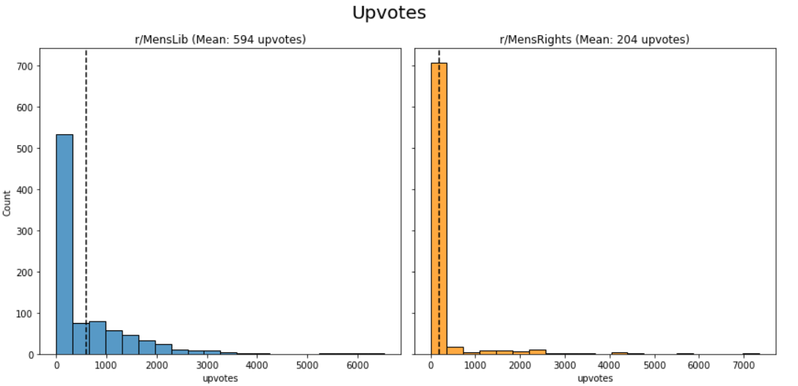
EDA
Notes:
Men’s Rights: 287k subscribers
Men’s Lib: 152k subscribers

Slide 6
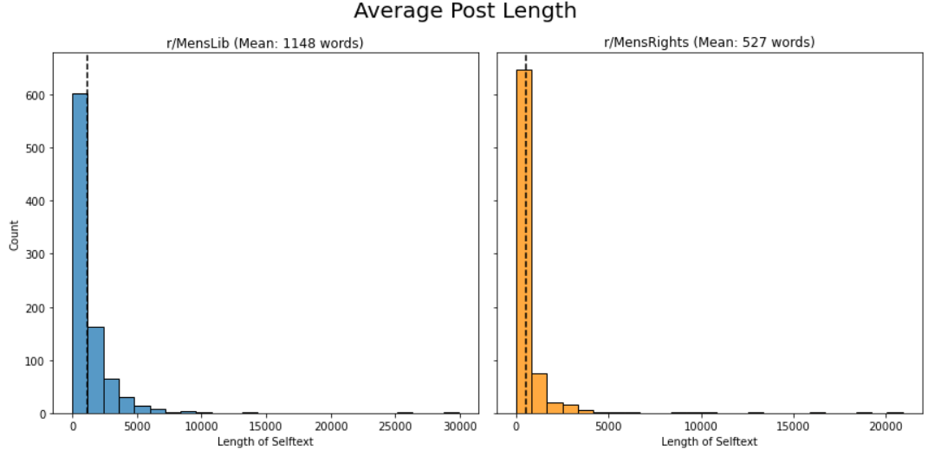
EDA

Slide 7
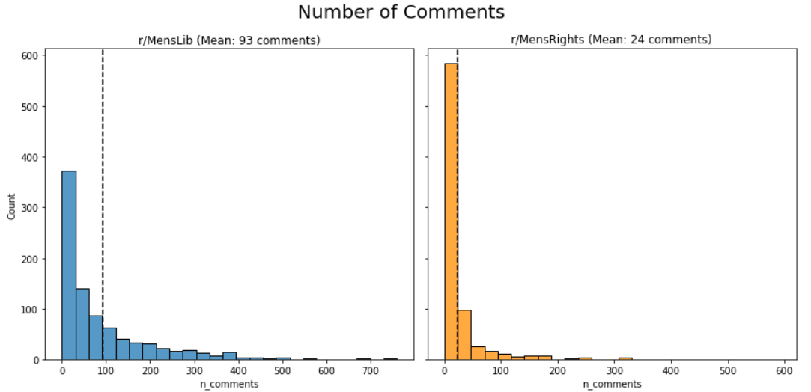
EDA

Slide 8
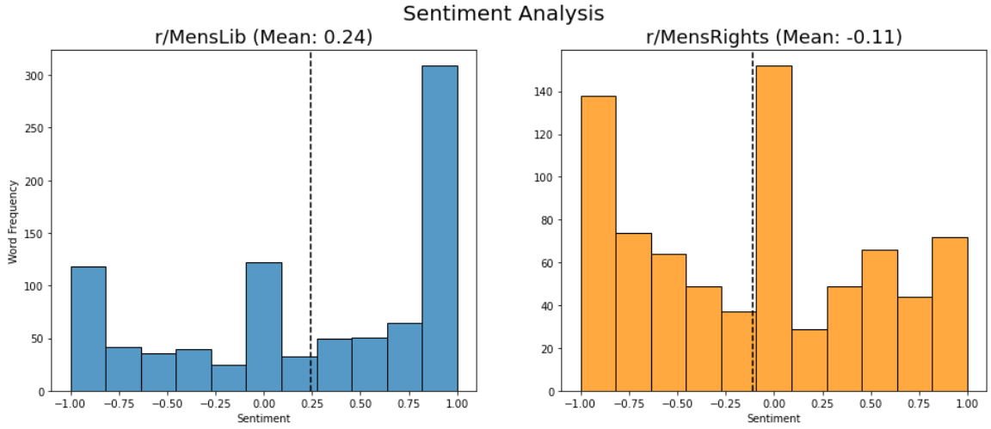
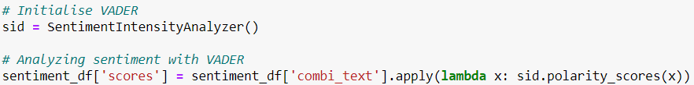
EDA

Slide 9
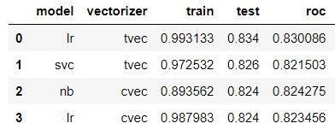
Model Selection
Logistic Regression with TfidfVectorizer:
Test accuracy: 0.834
AUC-ROC score: 0.830
Includes only words or n-grams that appear in at least 4 posts
Excludes stop words and ignores terms that that appear in more than 20% of posts
Uses Ridge regularization (𝛼 = 0.1 | C = 10)
Notes:
For fun, I also experimented with a logistic regression model that used purely numerical features including ['upvotes', 'n_comments', 'title_len', 'selftext_len', 'compound’]
Returned an accuracy score of 0.712 on test data – this is a pretty big step up from the baseline model which had a 53% accuracy.
Min_df = 4, max_df = 0.2

Slide 10
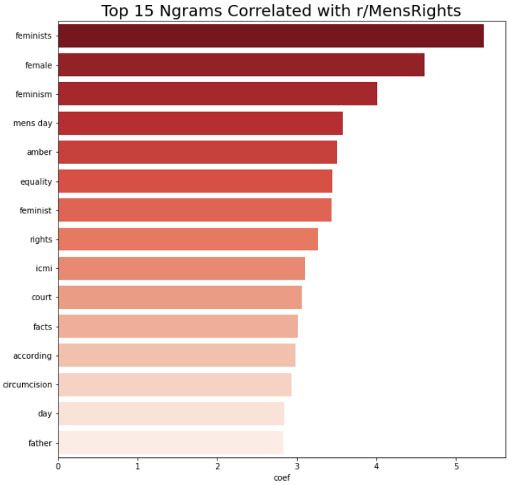
r/MensRights: Anti-Feminist Rants
Top 15 Ngrams for r/MensRights
So a common argument feminists LOVE to use is the “feminism cares about men’s issues too” bullshit line used, well the nice thing about today (international men’s day) is it really proves them wrong, go look at every single feminist sub on Reddit, every feminist page on Facebook, any feminists blog or journal.... guess what, radio silent on men’s issues on the one day of the year dedicated to men’s issues, yet every men’s rights page and sub is covered in IMD posts. Feminism straight up does not care about men’s issues and this proves it. Feminism is not about equality but supremacy. Feminism hates men.

Slide 11
r/MensRights: False Accusations Against Men e.g. Amber Heard
Top 15 Ngrams for r/MensRights
“Sign to push for Amber Heard to be fired. Why? Because men are targeted and women get let off”
“Johnny Depp loses to amber heard. Where is the justice?”
“Johnny Depp Is Being Blackmailed by Amber Heard”
“The amber heard situation is the best way to expose misandrist, and how people believe women more. People who defend amber heard are misandrist who knows nothing about false allegations. And the people defending her are so caught up in the “believe all women” bull shit that they are being completely blind of the truth.”

Slide 12
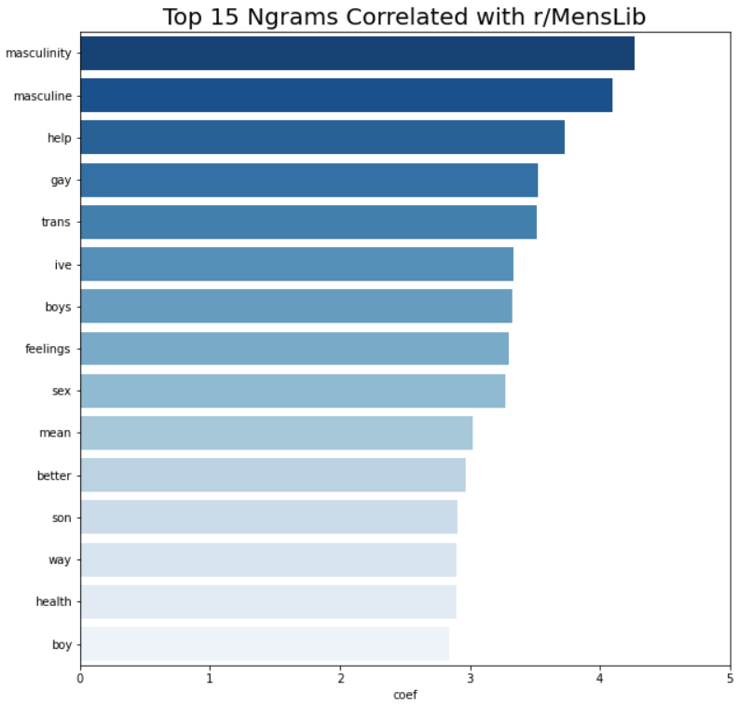
r/MensLib: Questioning ‘Traditional’ Masculinity
Top 15 Ngrams for r/MensLib
“Whether I’m on a basketball court, in a boardroom, at the pub, or in the bedroom, my masculinity will be different in each context [...] It’s a performance, and it changes based not only on the setting, but also the other players taking part in the scene.”
“It's obvious that *toxic* masculinity is bad, but what about concepts of masculinity and femininity as a whole? Are they necessary to keep around, or do they only exist to put people in boxes and perpetuate stereotypes? “

Slide 13
r/MensLib: Discussion of LGBTQ/POC Issues
Top 15 Ngrams for r/MensLib
“It didn't take me very long even as a kid to realize that I didn't really fit the societal image of what a black man should be… I never did grow into common cultural image of black men as tall, muscular, sexy and confident”
“I am also a disabled man. I will never be a "protector" or any number of modern dominant culture stereotypes […] Not meeting those stereotypes AND finding a powerful masculinity in myself is an active part of my liberation”
“I am a trans man and "man" is an active part of who I am, day and day out”

Slide 14
Where the Model Fails
Shared Issues & Topics:
“Could 6 hour shifts improve men's mental health? Finland and Sweden are slowly moving towards a 6 hour shift workday while maintaining the 8 hour pay. Do you think this could help men's mental health? Keep in mind companies see an increase in productivity and they could hire 30% more workers for the extra shift and employees are less stressed!” – misclassified as r/MensLib
“The Trial of Johnny Depp and Amber Heard. Hi all, first off, I wanted to say I love this group. Everyone here seems so level headed, engaging and takes time to read posts carefully. What a fabulous lot. I have been thinking about the current domestic abuse trial between Amber Heard and Johnny Depp” – misclassified as r/MensRights
Short Posts:
“Supreme Court says federal law protects LGBTQ workers from discrimination. There is a bias against men in family court says Karen Straughan.” – misclassified as r/MensRights
“Creative Men support group. I have a weekly men’s support group for Creative Men or men that aspire to be more creative. We meet on Saturdays from 1-3pm CST. The topic today will be collaboration and networking. “– misclassified as r/MensLib

Slide 15
Conclusion
When it comes to the wire, both subreddits care deeply about similar issues facing men (e.g. male suicide, male parenting), even if their approach and beliefs are fundamentally different.
To further improve model accuracy, we'd ideally need to train our model to recognize more abstract concepts such as the level of introspection or sentiment within the post.
This would allow our model to deal with issues that are topical to r/MensRights (e.g. Johnny Depp and Amber Heard) and classify posts not just by mention of a name, but also by syntactic patterns that suggest introspection and openness such as like 'I have been thinking' or 'I'd love to hear people's views'.

Slide 16
Appendix

Slide 17
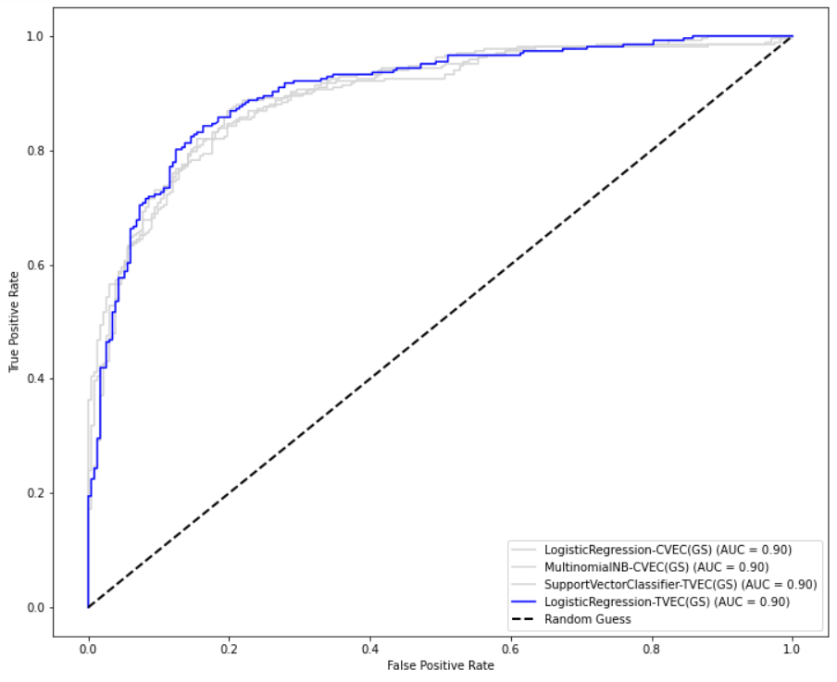
AUC-ROC Curve

Slide 18
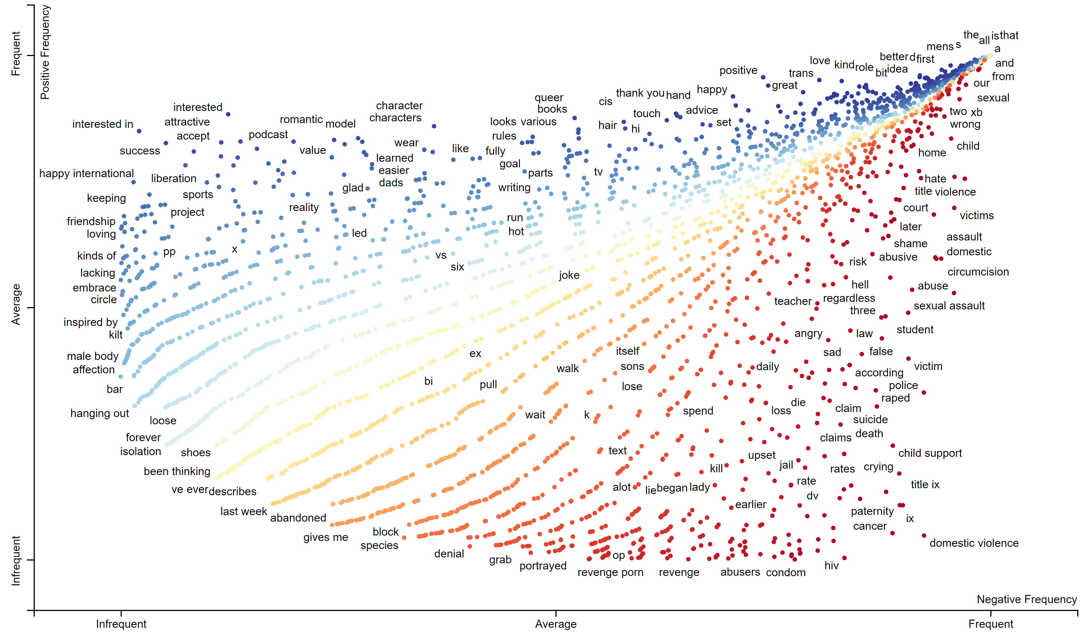
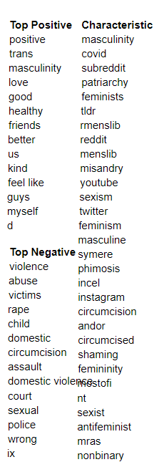
Sentiment - Alternative Classification Measures

Slide 19
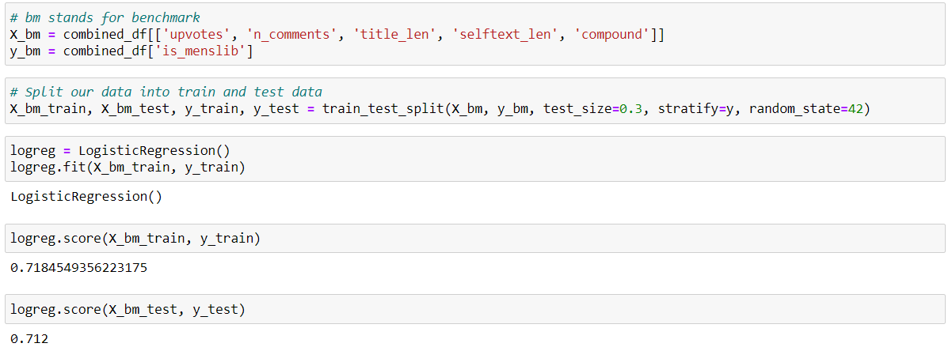
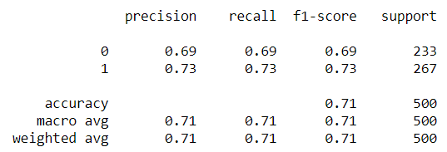
Numeric Logistic Regression Model

Slide 20
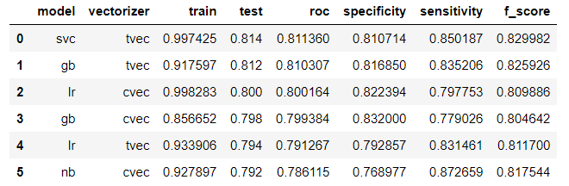
Results before tuning

Slide 21
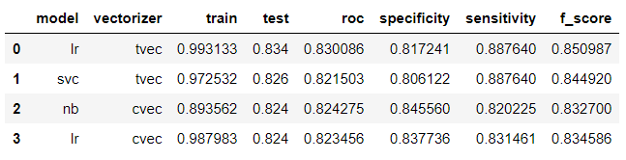
Full Model Performance
Notes:
0.81 specificity → 19% of posts are misclassified as false positive (predicted r/MensLib but actually r/MensRights)
0.88 sensitivity → 12% of posts are misclassified as false negative (predicted r/MensRights but actually r/MensLib)

Slide 22
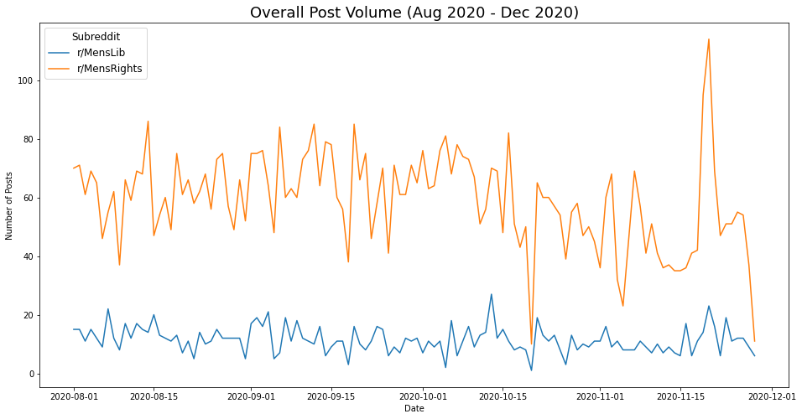
Volume of Posts

